Slide 1

ANALYTICS AVENUE
TALENTENA EVENT - 2024

Slide 2

ANALYTICS AVENUE - INTRO
Analytics Avenue is a leading educational platform specializing in data science and analytics guidance.
Tailored for students, transitioning professionals, and the unemployed, it offers expertise in SQL, Power BI, Python, Data Science, and Machine Learning.
With mentors boasting 5+ years of industry experience, Analytics Avenue emphasizes hands-on learning through real-time projects.

Slide 3
ABOUT ME
I'm Abinaya Palanisamy, a final-year Computer Science student.
Completed the Google Data Analytics Professional Certificate.
Currently interning at Analytics Avenue, I’m diving into Data Analysis through hands-on projects, aligning theory with real-world practice.
I’m set to make my mark in the dynamic world of data science.
View My resume

Slide 4

INSIGHTS INTO IMPACTS OF TAMIL NADU SCHEMES 2021-23 - PROBLEM STATEMENT
The absence of a systematic framework limits informed decision-making and resource allocation.
There is a critical need for an integrated platform to process and interpret scheme-related data, providing actionable insights for policymakers to optimize resource utilization and address diverse socioeconomic needs efficiently.

Slide 5

INSIGHTS INTO IMPACT: ANALYZING TAMILNADU GOVERNMENT SCHEMES AND COMMUNITY RESPONSES
This analysis aims to assess the implementation, reach, and impact of these schemes on targeted communities.
By studying utilization rates, community engagement, and the tangible outcomes, the objective is to provide insights that aid in refining these initiatives to better serve the needs of the people and improve overall governance.
View the data

Slide 6
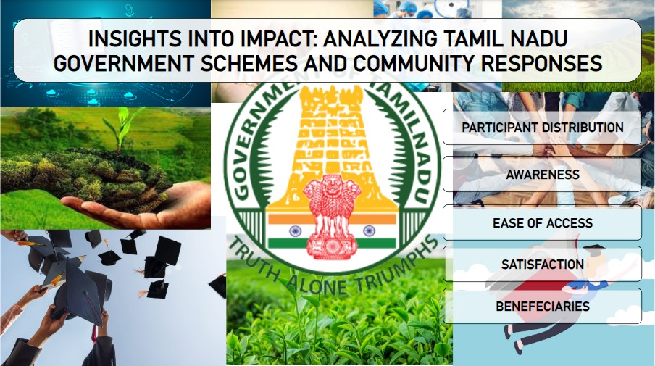

Slide 7
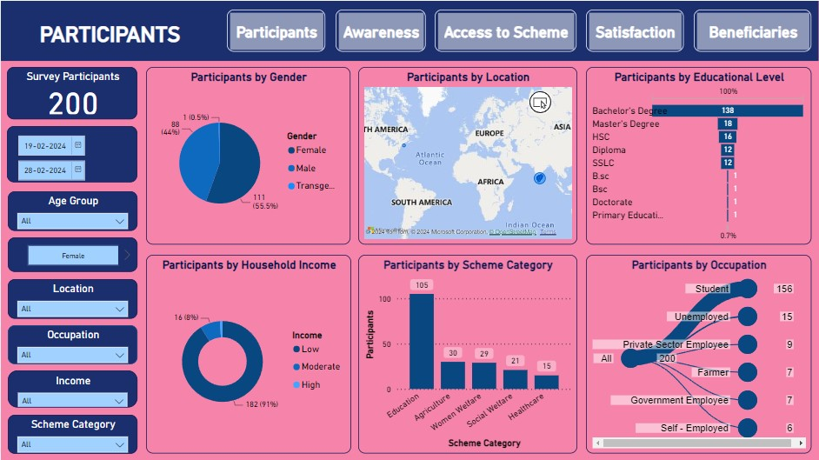

Slide 8
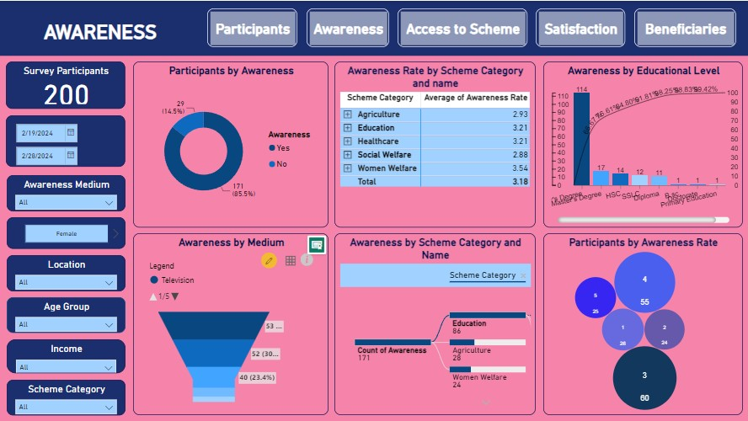

Slide 9
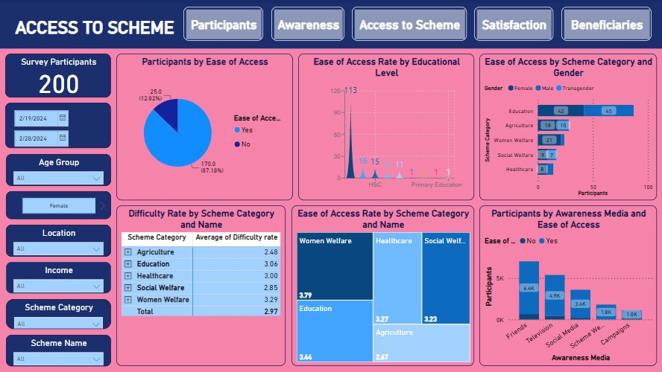

Slide 10
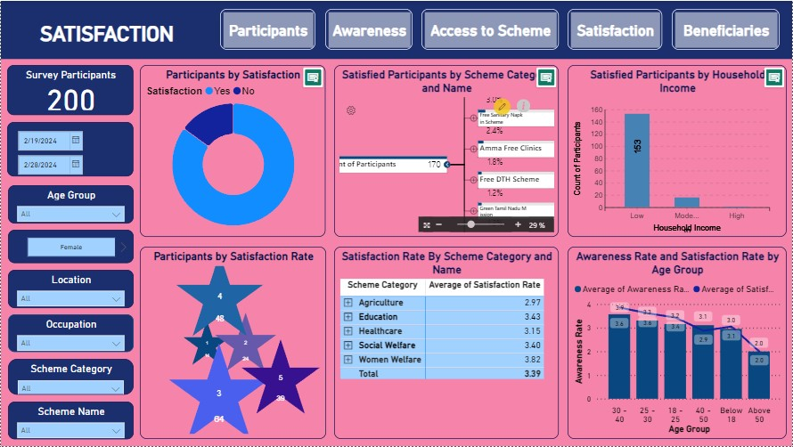

Slide 11
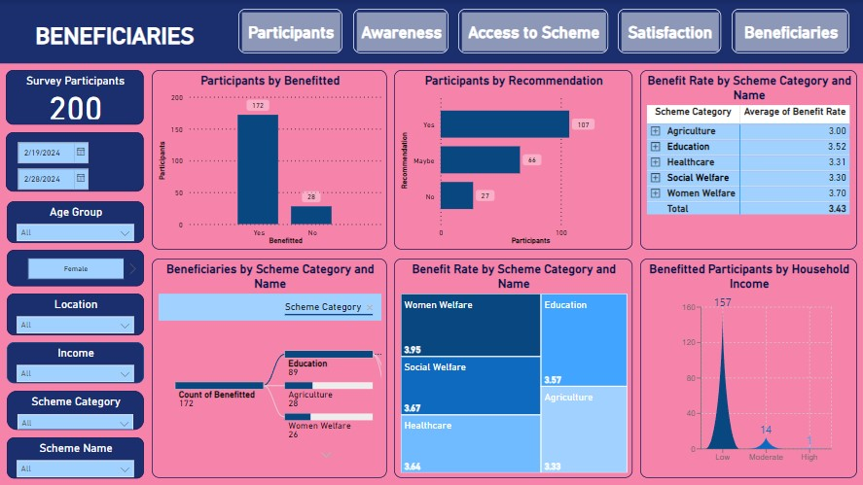

Slide 12
KEY INSIGHTS
Highest number of survey participants belong to the age group 18-30 shows that youngsters are benefitting from the schemes more followed by the age group 41-50.
Participants who are studying or their Bachelor’s Degree are highest population in the survey.
Most of the participants are female.
Most people are aware of the newly introduced schemes.
Most Participants are benefitted from educational Schemes.
Women Welfare Scheme has the highest awareness of all the scheme categories.
Social Welfare Schemes has the least awareness of all the scheme categories.
Women Welfare Schemes have highest satisfaction rate.
Women Welfare schemes have the highest benefit rate.
Most participants are benefitted from educational schemes.

Slide 13

USE CASES
Policy Refinement: Helps refine policies, ensuring they align better with community needs and expectations.
Resource Allocation: Analysis assists in directing resources.
Enhanced Governance: Leading to improved governance and better-targeted interventions.
Community Engagement: To foster greater community engagement and participation in governance and development initiatives.
Improving Accountability: Enhancing accountability and transparency in public administration.

Slide 14

THANK YOU

